Slide 1
Index of Multiple Deprivation 2019

Slide 2
What is the Index of Multiple Deprivation (IMD)
Measures relative levels of deprivation in 32,844 small areas called Lower-layer Super Output Areas, in England. For example, a better rank in relation to Crime does not mean that Crime levels are falling, simply that Crime is not rising as quickly as other local authorities.
The Index is made up of the following deprivation sub-categories:-
Income (22.5%)
Employment (22.5%)
Education, Skills and Training (13.5%)
Health and Disability (13.5%)
Crime (9.3%)
Barriers to Housing and Services (9.3%)
Living Environment (9.3%)
Income has two sub categories relating to:
Children
Older People

Slide 3
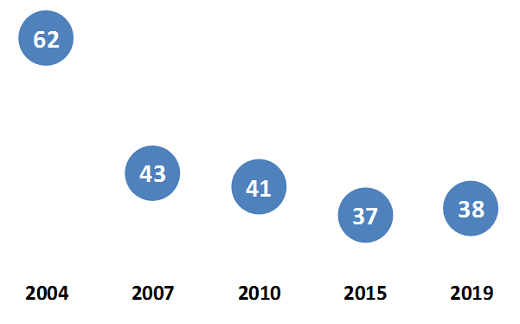
IMD Local authority rank - England
Local Authority Deprivation Rank for Upper-tier local authority - Torbay
Less deprived
More deprived
Torbay is ranked as the 38th most deprived upper-tier local authority out of 151 for 2019.
Torbay is ranked as the 48th most deprived district out of 317 districts in England.

Slide 4
IMD Local authority rank – South West
Local Authority Deprivation Rank for Upper-tier local authority (1 = Most deprived)
 | 2004 | 2010 | 2019
Torbay | 62 | 41 | 38
Plymouth | 57 | 60 | 52
Cornwall | 61 | 61 | 60
Devon | 95 | 99 | 110
Torbay is ranked as the most deprived upper-tier local authority in the South West out of 15 for 2019. Torbay has been in this position since 2007.
Torbay is ranked as the most deprived district out of 30 districts in the South West. Torbay has been in this position for the last two IMDs.

Slide 5
Most deprived areas - Torbay
Torbay LSOAs classified as being amongst the 20% most deprived areas in England
Number of Torbay LSOAs - 89
2019 – 27% of Torbay population live in the 20% most deprived areas in England.
2015 – 32% of Torbay population lived in the 20% most deprived areas in England.

Slide 6
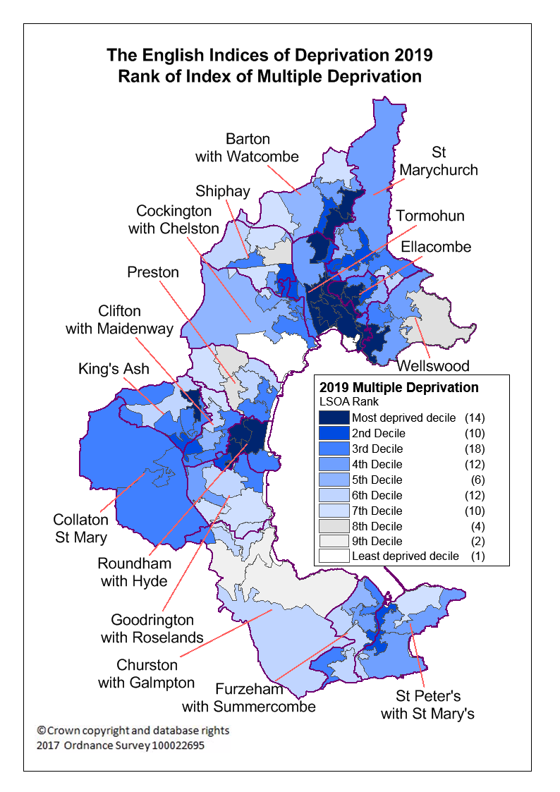
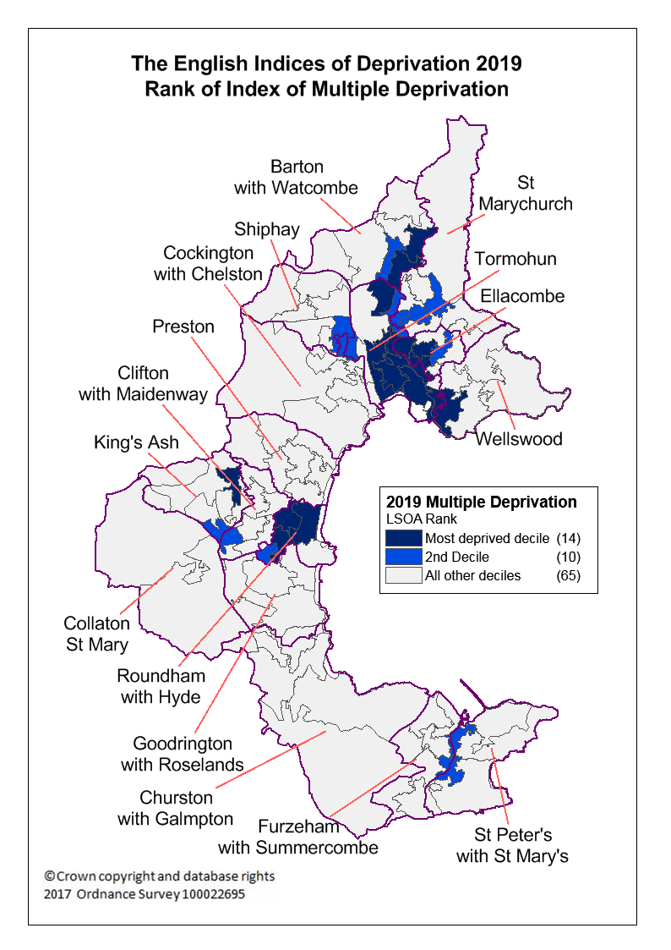
IMD Map - Torbay
Notes:
Map on right is the same as map on left, just that everything from Decile 3 to Decile 10 is in grey, so as to highlight most deprived areas.

Slide 7
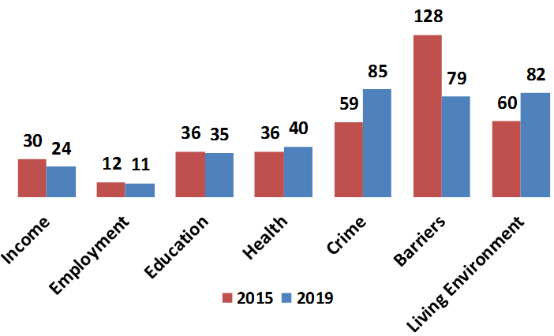
Domain Deprivation - Torbay
Torbay Deprivation rank for 7 sub-domains that make up the IMD for Upper Tier local authorities
Less deprived
More deprived
2019 – 151 local authorities, 2015 – 152 local authorities.
Most significant fall in rating relates to Barriers to Housing and Services, most significant rise in rating relates to Crime.

Slide 8
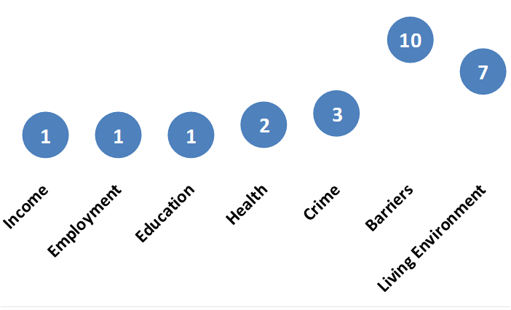
Deprivation Domains within South West - Torbay
Torbay Deprivation rank for 7 sub-domains that make up the IMD for Upper Tier local authorities in the South West - 2019
Less deprived
More deprived
2019 – 15 local authorities, 2015 – 16 local authorities.
All rankings remain the same as 2015 except Barriers to Housing and Services from fall from the its 2015 rank of 16.

Slide 9
Barriers to Housing and Services - Torbay
Torbay has seen a significant level of movement in this indicator
Indicator has two sub-domains:-
Geographical Barriers: Road distance to post office, primary school, general store/supermarket, GP surgery. – No significant change.
Wider Barriers: Household overcrowding, Homelessness, Housing Affordability – The movement of the indicator relates to this sub-domain, in particular to worsening housing affordability compared to other local authorities. Also Torbay had a worsening rank in relation to homelessness.

Slide 10
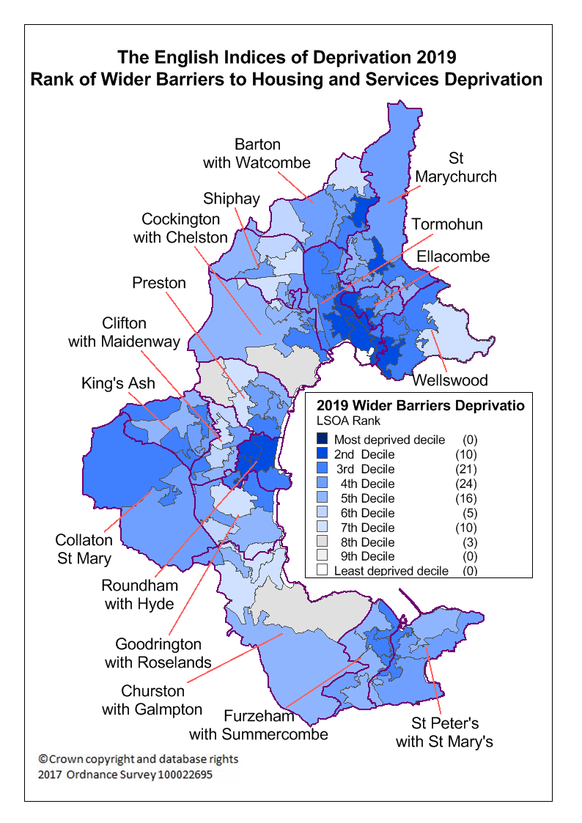
Wider Barriers Deprivation - Torbay
Wider Barriers relate to issues affecting access to housing. The three measures within it relate to Household overcrowding, homelessness and housing affordability
16,200 people within Torbay live in an area that is amongst the 20% most deprived in relation to wider barriers deprivation for England (2015 – 1,700).

Slide 11
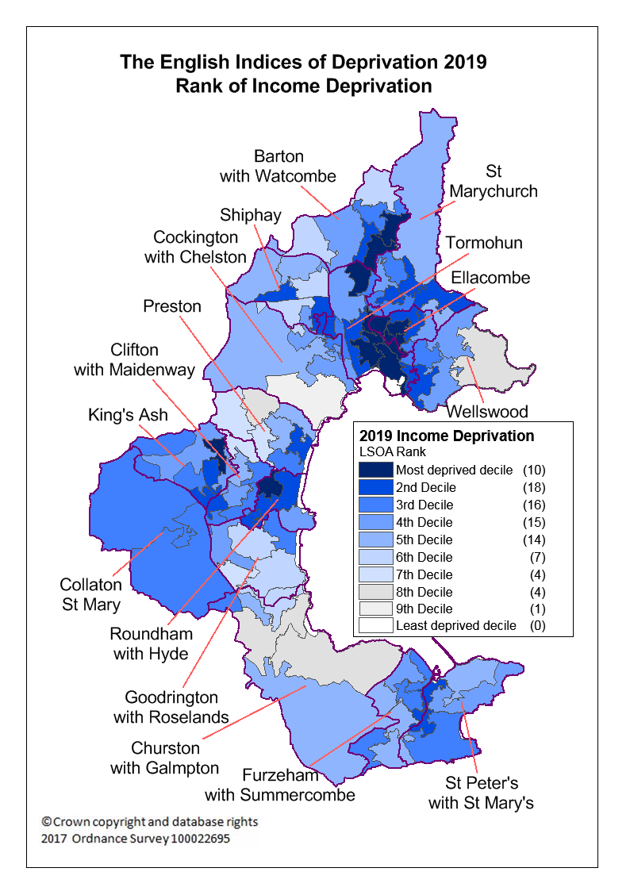
Income Deprivation - Torbay
Income deprivation relates to the proportion of the population experiencing deprivation relating to low income.
Includes measures such as those in receipt of Income based benefits.
2019 rank of 24th most deprived upper-tier local authority out of 151 (2015 – 30th).
32% of Torbay residents live in area that is amongst the 20% most deprived areas in relation to income for England. (2015 – 32%).
Notes:
Income Deprivation consists of:-
Adults and children in Income Support families
Adults and children in Income-based Jobseeker's Allowance families
Adults and children in income-based Employment and Support Allowance families
Adults and children in Pension Credit (Guarantee) families
Adults and children in universal Credit families where no adult is classed within the 'Working - no requirements' conditionality group
Adults and children in Working Tax Credit & Child Tax Credit families not already counted in the five measures above, whose equivalised income (excluding housing benefit) is below 60 per cent of the median before housing costs
Asylum seekers in England in receipt of subsistence support, accommodation support, or both (Not included in the Children or Older People sub-domains)

Slide 12
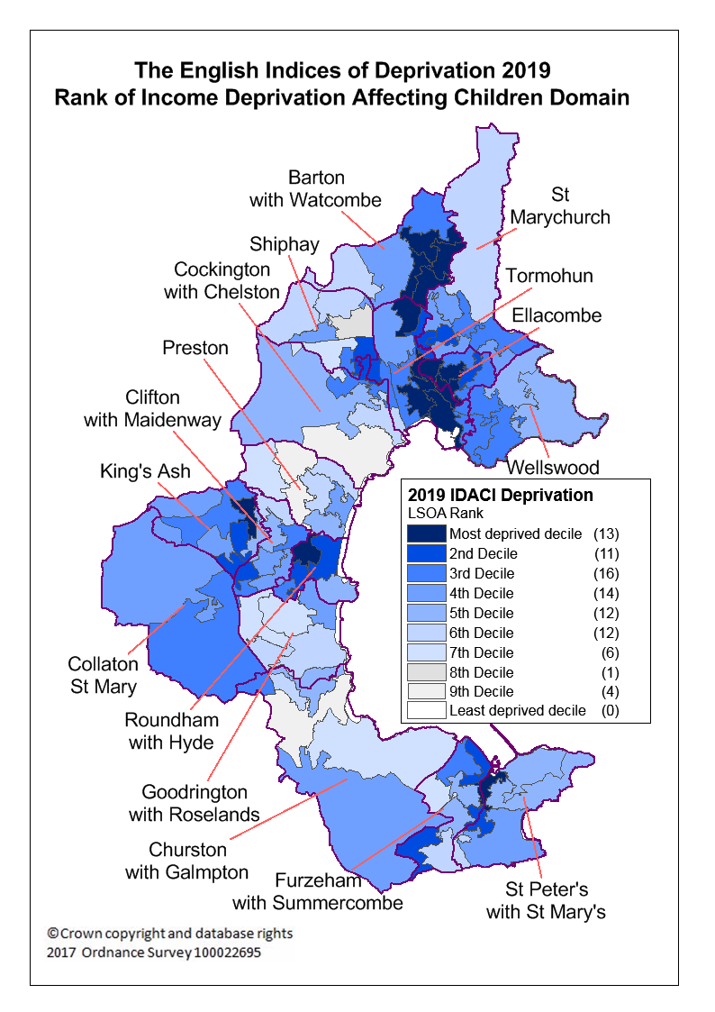
Income Deprivation Affecting Children Index (IDACI) - Torbay
This is a sub-domain of Income Deprivation and its effect on children aged 0 to 15
2019 rank of 30th most deprived upper-tier local authority out of 151 (2015 – 39th).
2019 rank of most deprived upper-tier local authority in South West (2015 – 1st)
30% of Torbay children live in an area that is amongst the 20% most deprived in relation to income deprivation affecting children for England. (2015 – 29%).

Slide 13
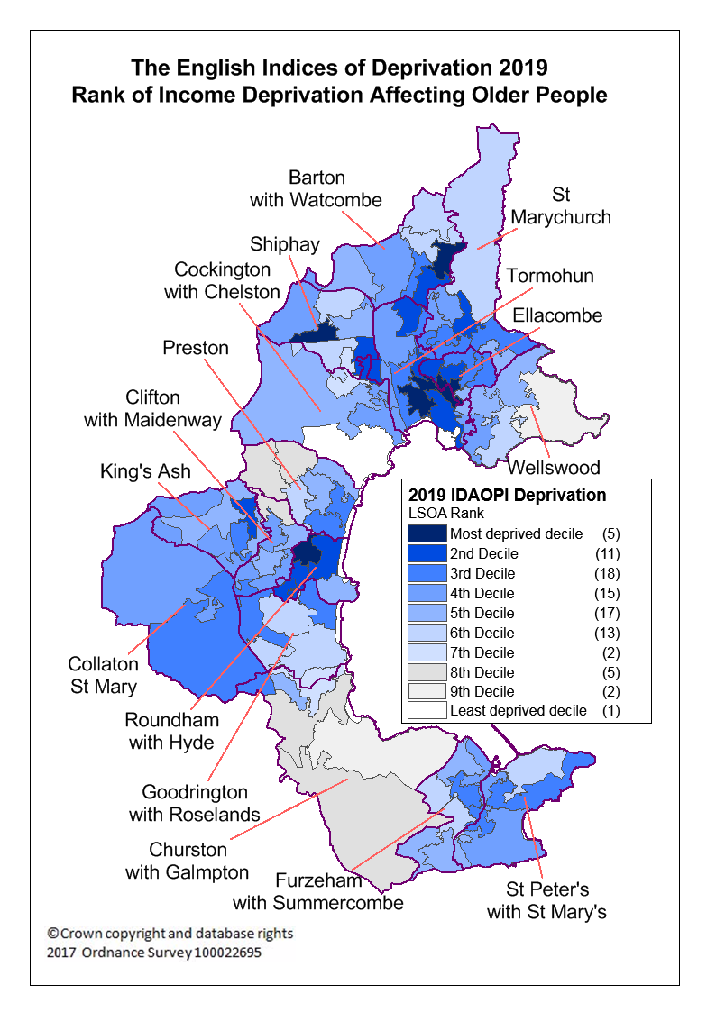
Income Deprivation Affecting Older People Index (IDAOPI) - Torbay
This is a sub-domain of Income Deprivation and its effect on people aged 60 and over
2019 rank of 42nd most deprived upper-tier local authority out of 151 (2015 – 44th).
2019 rank of most deprived upper-tier local authority in South West (2015 – 1st)
14% of older people in Torbay live in an area that is amongst the 20% most deprived in relation to income deprivation affecting older people for England. (2015 – 16%).

Slide 14
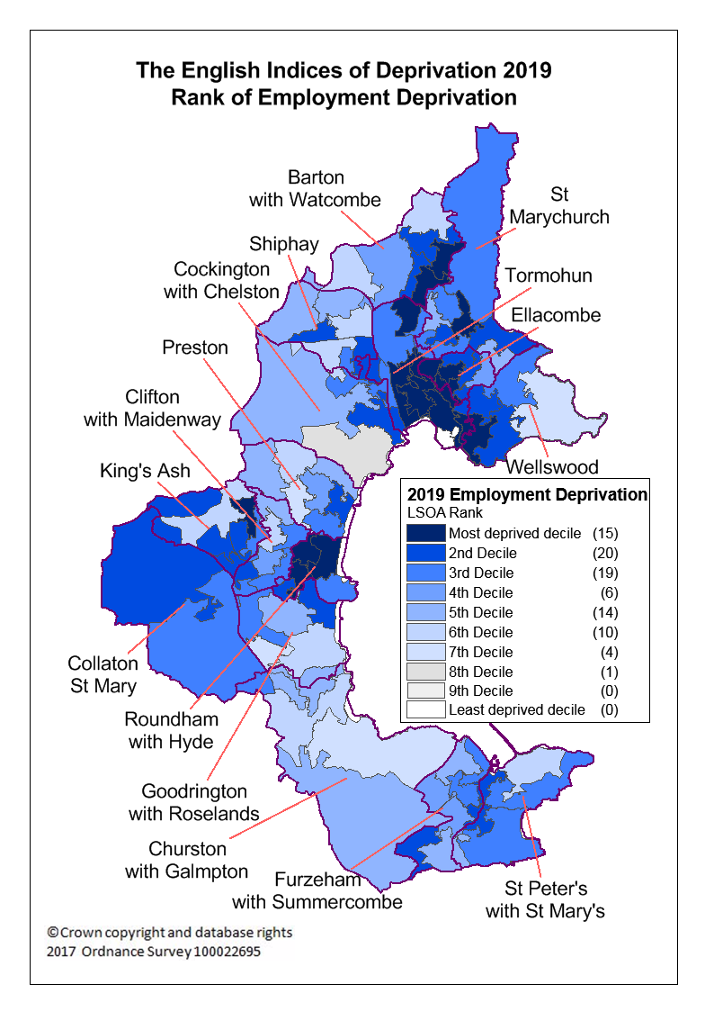
Employment Deprivation - Torbay
It measures the proportion of the working age population involuntarily excluded from the labour market. This can be due to unemployment, sickness, disability or caring responsibilities.
2019 rank of 11th most deprived upper-tier local authority out of 151 (2015 – 12th). Most deprived within South West (2015 – Most deprived).
42% of those mentioned in the first point (above) within Torbay live in an area that is amongst the 20% most deprived in relation to employment deprivation for England. (2015 – 42%).

Slide 15
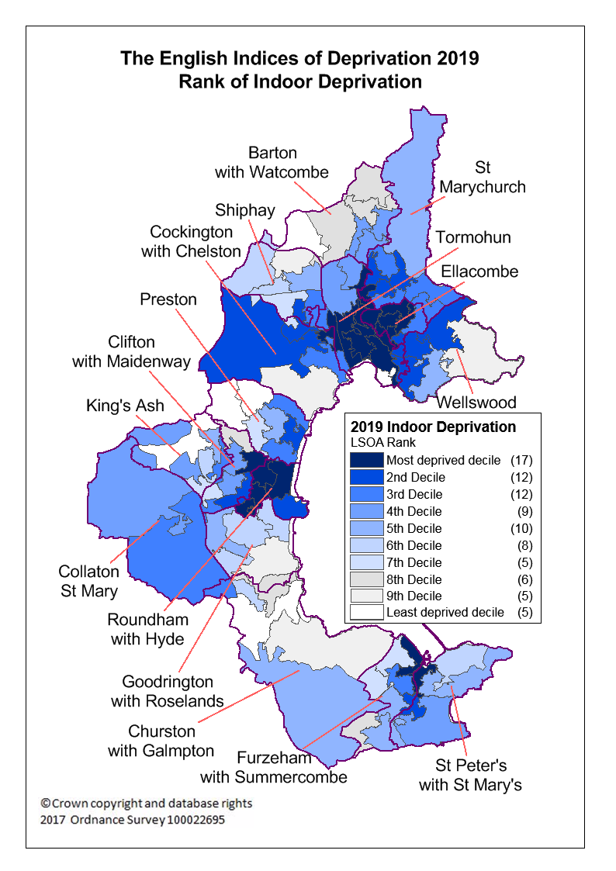
Indoor Deprivation - Torbay
It measures the quality of housing, specifically the proportion of houses that do not have central heating and proportion of social and private homes that fail to meet the Decent Homes standard.
33% of people within Torbay live in an area that is amongst the 20% most deprived in relation to indoor deprivation for England. (2015 – 32%).

Slide 16
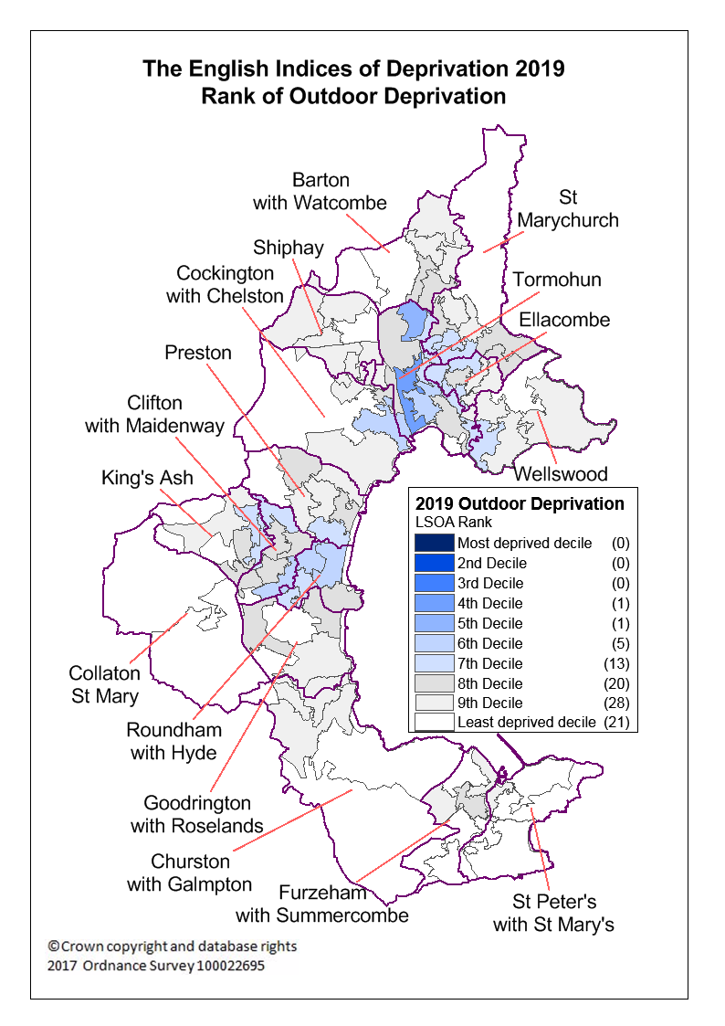
Outdoor Deprivation - Torbay
It measures air quality and road traffic accidents involving injury to pedestrians and cyclists.
No-one within Torbay lives in an area that is amongst the 20% most deprived in relation to outdoor deprivation for England (2015 – 0%).
55% of people within Torbay live in an area that is amongst the 20% least deprived in relation to outdoor deprivation for England (2015 – 28%)

Slide 17
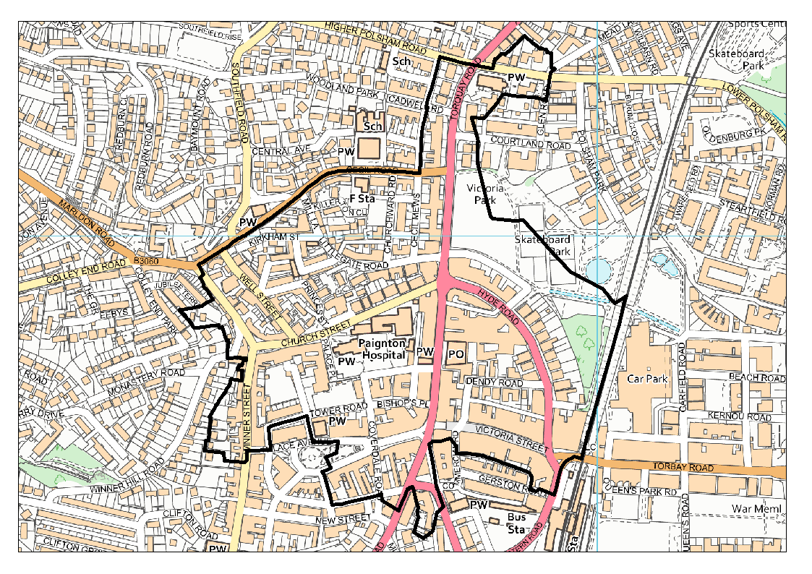
Most Deprived area - Torbay
Central Paignton (Ranked 198th most deprived out of 32,844 English LSOAs)

Slide 18
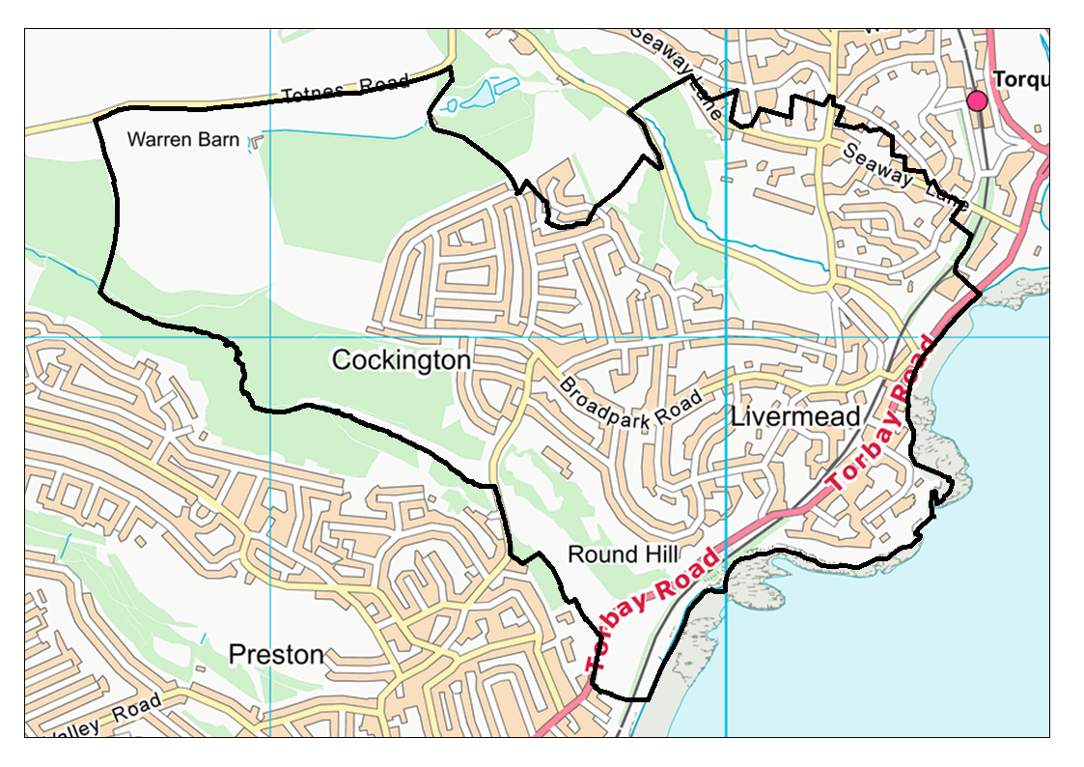
Least Deprived area - Torbay
Livermead & Cockington (Ranked 30,108th most deprived out of 32,844 English LSOAs)

Slide 19
Comparison (Domains) - Torbay
Comparison of most and least deprived LSOA in Torbay – 2019 IMD
1=Most deprived decile in England, 10=Least deprived decile in England
Domain of Deprivation | Central Paignton | Livermead and Cockington
Income | 1 | 9
Affecting Children | 1 | 9
Affecting Older People | 1 | 10
Employment | 1 | 8
Education, Skills & Training | 1 | 10
Children and young people | 1 | 10
Adult skills | 2 | 9
Health | 1 | 8
Crime | 1 | 7
Notes:
Income:-
Adults and children in Income Support families
Adults and children in Income-based Jobseeker's Allowance families
Adults and children in income-based Employment and Support Allowance families
Adults and children in Pension Credit (Guarantee) families
Adults and children in universal Credit families where no adult is classed within the 'Working - no requirements' conditionality group
Adults and children in Working Tax Credit & Child Tax Credit families not already counted in the five measures above, whose equivalised income (excluding housing benefit) is below 60 per cent of the median before housing costs
Asylum seekers in England in receipt of subsistence support, accommodation support, or both (Not included in the Children or Older People sub-domains)
Employment
Claimants of Jobseeker's Allowance (both contribution-based and income-based), women aged 18 to 59 and men aged 18 to 64
Claimants of Employment and Support Allowance (both contribution-based and income-based), women aged 18 to 59 and men aged 18 to 64
Claimants of Incapacity Benefit, women aged 18 to 59 and men aged 18 to 64
Claimants of Severe Disablement Allowance, women aged 18 to 59 and men aged 18 to 64
Claimants of Carer's Allowance, women aged 18 to 59 and men aged 18 to 64
Claimants of Universal Credit in the 'Searching for work' and 'No work requirements' conditionality groups who are of working age (18 to 59 for females and 18 to 64 for males)
Education, Skills and Training
Children & young people sub-domain:-
Key Stage 2 attainment - Maths, English reading and English grammar, punctuation and spelling
Key Stage 4 attainment
Secondary school absence
Staying on in education post 16
Entry to higher education
Adult skills sub-domain :-
Proportion of working-age adults with no or low qualifications, women aged 25 to 59 and men aged 25 to 64
Proportion of working-age adults who cannot speak English or cannot speak English well, women aged 25 to 59 and men aged 25 to 64

Slide 20
Comparison (Domains) - Torbay
Comparison of most and least deprived LSOA in Torbay – 2019 IMD
1=Most deprived decile in England, 10=Least deprived decile in England
Domain of Deprivation | Central Paignton | Livermead and Cockington
Barriers to Housing & Services | 6 | 8
Geographical Barriers | 10 | 4
Wider Barriers | 2 | 8
Living Environment | 1 | 10
Indoors | 1 | 9
Outdoors | 6 | 9
Notes:
Barriers to Housing: Geographical barriers are Road distance to:-
Post Office,
Primary School,
General Store or supermarket,
GP Surgery
Wider barriers are:-
Household overcrowding,
Homelessness,
Housing Affordability
Living Environment: Indoors makes up 66.7% of the indicator:-
Houses without central heating,
Housing in poor conditions (English Housing Survey)
Outdoors makes up 33.3% of the indicator:-
Air quality,
Road traffic accidents involving injury to pedestrians and cyclists

Slide 21
Other comparison groups
CIPFA – 5 most deprived authorities (1 = Most deprived)
Local Authority | 2010 | 2015 | 2019
Blackpool | 10 | 4 | 1
St.Helens | 49 | 41 | 32
Torbay | 41 | 37 | 38
Redcar and Cleveland | 53 | 55 | 48
North East Lincolnshire | 58 | 49 | 51
Children’s comparator group – 5 most deprived authorities (1 = Most deprived)
Local Authority | 2010 | 2015 | 2019
Blackpool | 10 | 4 | 1
Torbay | 41 | 37 | 38
Rotherham | 42 | 47 | 40
Redcar and Cleveland | 53 | 55 | 48
North East Lincolnshire | 58 | 49 | 51
Notes:
CIPFA – Group of 15 comparators used in Public Health Outcomes Framework
Children’s comparator group – 10 comparators used as comparator for Children’s services

Slide 22
Comparison (Scores) - Torbay
Comparison of Income and Employment Scores – 2019 IMD
Domain of Deprivation | 2015 | 2019
Income | 19.1% | 17.4%
Affecting Children | 24.1% | 21.9%
Affecting Older People | 19.8% | 17.4%
Employment | 17.6% | 15.0%
Income and Employment domains have scores that show the proportion of individuals counted as deprived. For example, the table above shows that 17.4% of people within Torbay were classified as Income deprived for 2019, this is down from 19.1% in 2015.
For Income deprivation affecting children, 21.9% of under 16’s were classified as being affected by income deprivation, this is down from 24.1% in 2015.

Slide 23
Deprivation by ward - Torbay
Income
Employment
Tormohun | 26.5%
Roundham with Hyde | 25.5%
Ellacombe | 24.3%
King's Ash | 22.2%
Barton with Watcombe | 19.6%
Collaton St Mary | 18.1%
St Marychurch | 17.7%
St Peter's with St Mary's | 16.7%
Furzeham with Summercombe | 15.0%
Wellswood | 14.4%
Clifton with Maidenway | 14.3%
Shiphay | 13.7%
Cockington with Chelston | 13.3%
Preston | 11.8%
Goodrington with Roselands | 11.4%
Churston with Galmpton | 8.7%
Tormohun | 24.0%
Roundham with Hyde | 22.4%
Ellacombe | 19.5%
King's Ash | 17.6%
Collaton St Mary | 16.3%
Wellswood | 15.4%
Barton with Watcombe | 14.3%
St Marychurch | 14.0%
St Peter's with St Mary's | 13.1%
Furzeham with Summercombe | 12.3%
Clifton with Maidenway | 12.1%
Cockington with Chelston | 11.7%
Shiphay | 10.7%
Preston | 10.6%
Goodrington with Roselands | 10.4%
Churston with Galmpton | 8.3%
Relates to percentage of those in domain deprivation within each ward,
this is an estimate as IMD data is not published at ward level

Slide 24
Deprivation by ward - Torbay
Income Affecting Children
Income Affecting Older People
Tormohun | 31.1%
Roundham with Hyde | 30.8%
King's Ash | 30.2%
Ellacombe | 29.5%
Barton with Watcombe | 28.5%
St Peter's with St Mary's | 21.8%
Furzeham with Summercombe | 20.4%
St Marychurch | 20.3%
Collaton St Mary | 19.9%
Clifton with Maidenway | 18.4%
Cockington with Chelston | 16.8%
Wellswood | 16.6%
Shiphay | 15.1%
Churston with Galmpton | 12.4%
Goodrington with Roselands | 11.2%
Preston | 11.1%
Ellacombe | 26.0%
Roundham with Hyde | 25.4%
Tormohun | 24.8%
St Marychurch | 21.1%
Collaton St Mary | 20.2%
Barton with Watcombe | 19.0%
King's Ash | 19.0%
Shiphay | 17.6%
St Peter's with St Mary's | 17.5%
Furzeham with Summercombe | 15.8%
Clifton with Maidenway | 15.5%
Goodrington with Roselands | 15.5%
Preston | 14.7%
Cockington with Chelston | 12.0%
Wellswood | 11.5%
Churston with Galmpton | 8.8%
Relates to percentage of those in domain deprivation within each ward,
this is an estimate as IMD data is not published at ward level

Slide 25
Notes
Index of Multiple Deprivation - https://www.gov.uk/government/collections/english-indices-of-deprivation
Comparison of Local Authorities based on Rank of Average Rank measure.
Notes:
Barriers to Housing: Geographical barriers are Road distance to:-
Post Office,
Primary School,
General Store or supermarket,
GP Surgery
Wider barriers are:-
Household overcrowding,
Homelessness,
Housing Affordability
Living Environment: Indoors makes up 66.7% of the indicator:-
Houses without central heating,
Housing in poor conditions (English Housing Survey)
Outdoors makes up 33.3% of the indicator:-
Air quality,
Road traffic accidents involving injury to pedestrians and cyclists

